Slide 1

Project Details:
Project Title - Forecasting Air Quality Using Historical Pollution Data
Start Date - 22-September-2025
Project Purpose -
Predict air quality index (AQI) and pollutant levels using historical pollution data.
Help authorities, planners, and the public take preventive actions and make healthier decisions.
Tools and Technologies - HTML, CSS, Java Script, Streamlit, Flask, Jupyter Notebook, Github
Mentor - Ms. Umme Asma S
Team Number – 2
Intern Names - Shruti Singh, R Doondi Gangadhar, Rahul Vangari, Shiven Poojary, Payal Rawat
Github Repo- https://github.com/ShivenPoojary01/AirAware_TeamB?tab=MIT-1-ov-file

Slide 2
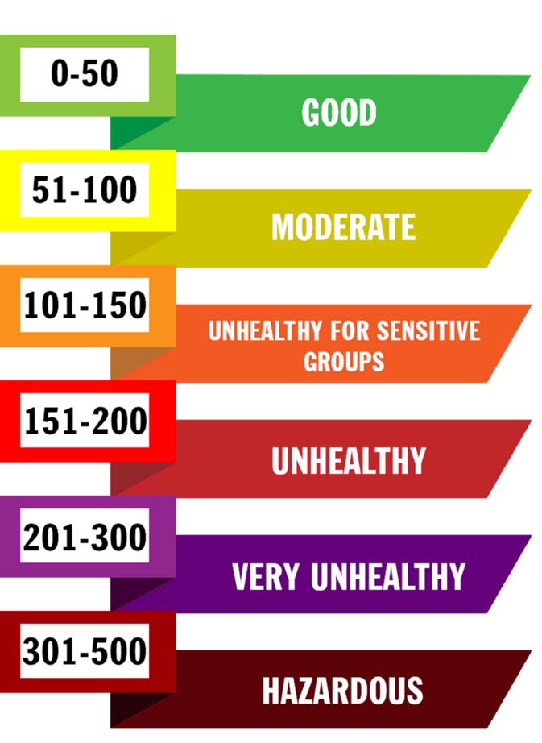

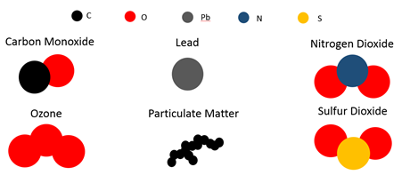

AQI and Factors
Factors Affecting AQI
Source:

Slide 3
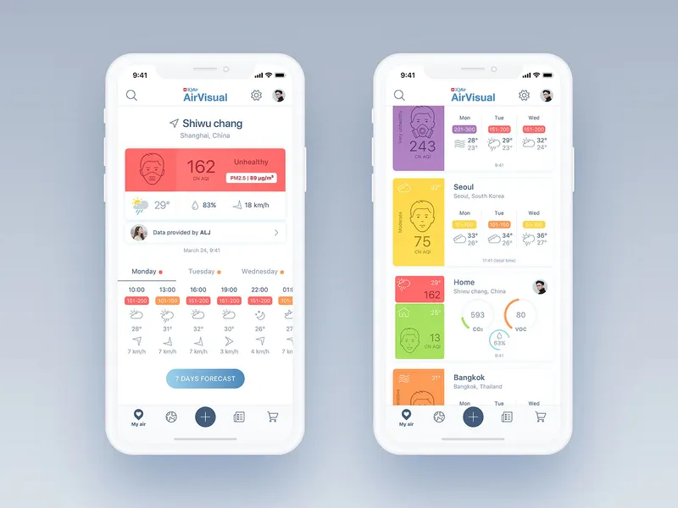
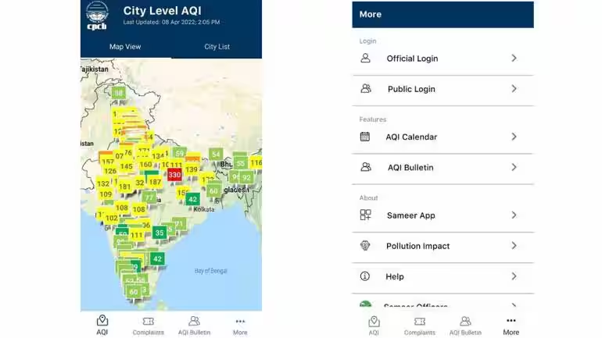
AQI Evaluation Agencies
Agencies
CPCB (Central Pollution Control Board)
SPCBs (State Boards)
Real-Time AQI Apps
SAMEER
AirVisual
AirVisual App interface
SAMEER App interface

Slide 4

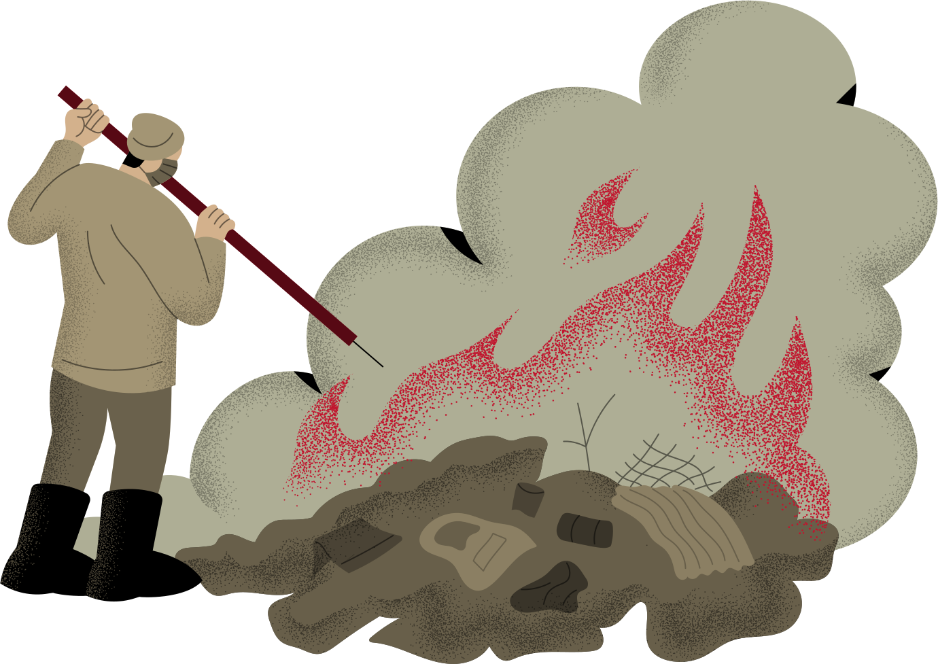




Major Contributors to Air Pollution
waste and
crop burning
17%
Industrial activities
51%
Vehicle emissions
27%
Dust and Construction
2%
Residential heating and cooking
2%
Biomass and waste
1%
Source:

Slide 5
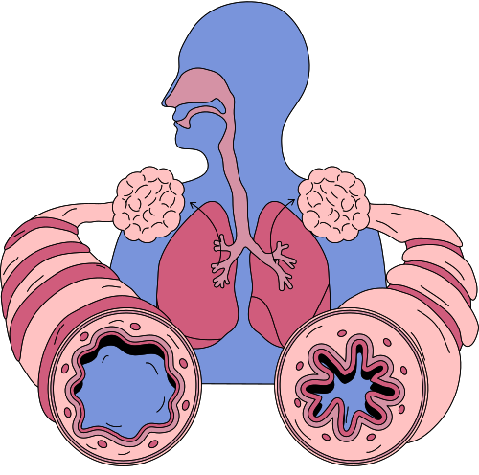



How is harmful to Humans and Earth
Effects on Humans
Effects on Earth
Respiratory diseases
Cardiovascular stress
Eye and skin irritation
Reduced life expectancy
Global Warming
Acid Rain
Studies (University of Chicago, Air Quality Life Index 2024) estimate Indians lose 5.3 years of life expectancy on average due to air pollution
Sources:

Slide 6




Solutions to Reduce Air Pollution
Air purifiers
Renewable energy sources.
Public awareness campaign
AQI Predictors

Slide 7
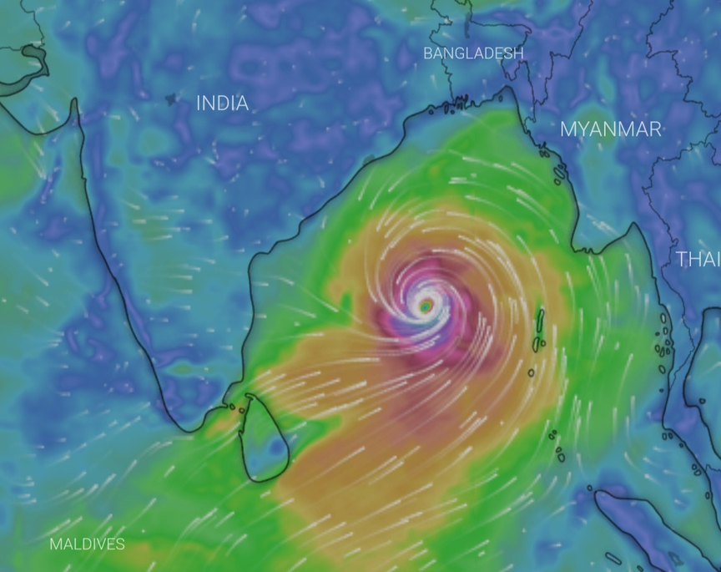

Project Impact and its Contribution
Case: Cyclone Montha (Oct 2025)
Andhra Pradesh and West Bengal
Govt Warning: Avoid nitrogen fertilizers during high AQI to protect crops.
Sources:

Slide 8



Future Enhancements
MOBILE APPLICATION
AWARD CITIZENS
IOT SENSOR INTEGRATION
DEEP LEARNING
MODELS

Slide 9
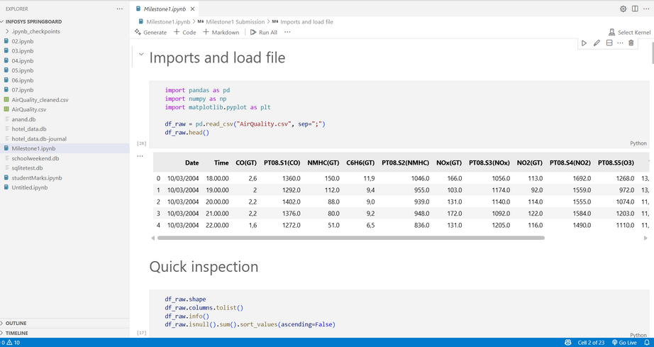
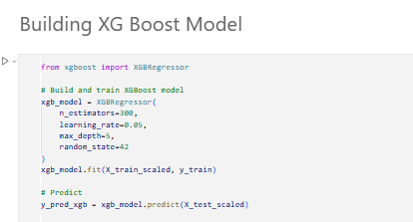
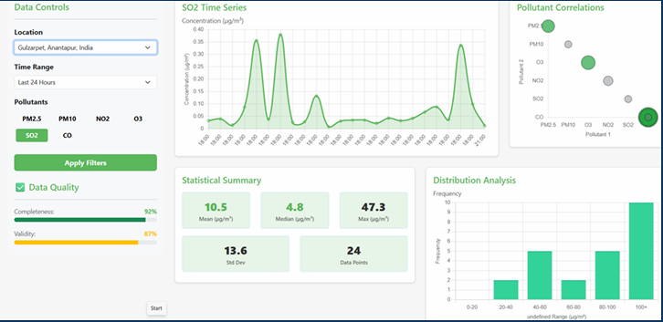
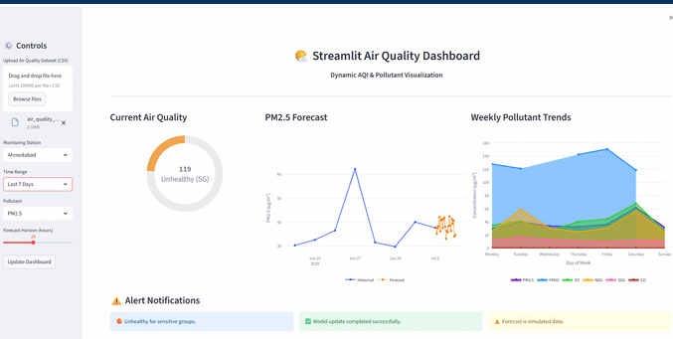
Milestone Highlights
Milestone 1. Data Preprocessing & EDA
Milestone 2. ML Model Training & Evaluation
Milestone 3.
1.Air Quality Data explorer 2 .Air Quality forecast engine
Milestone 4.
3.Air quality alert system 4.Streamlit Web Dashboard

Slide 10
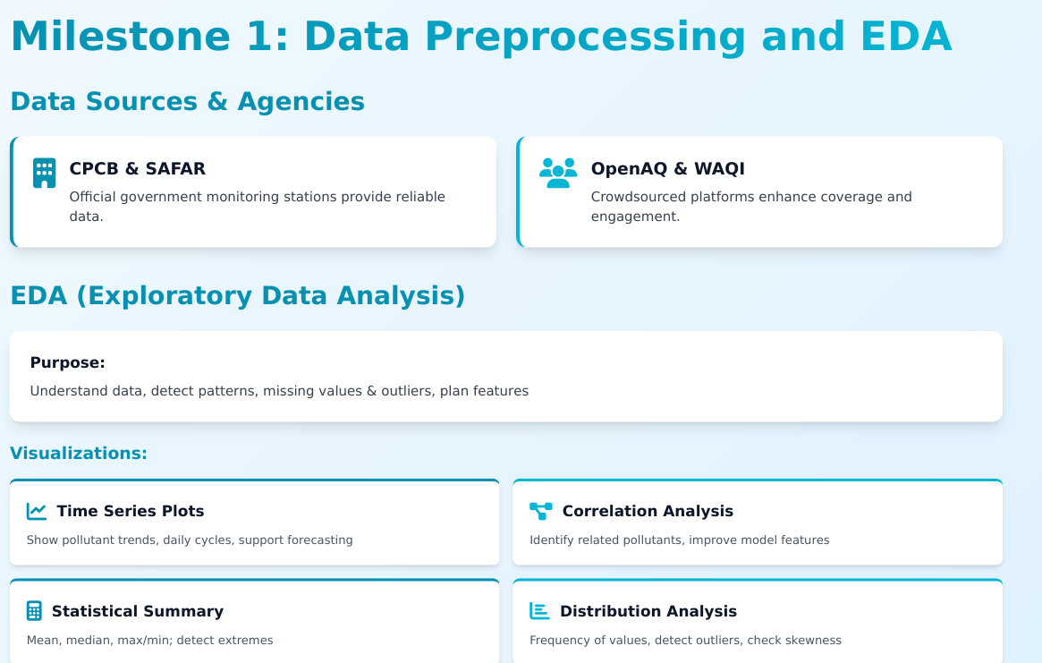

Slide 11
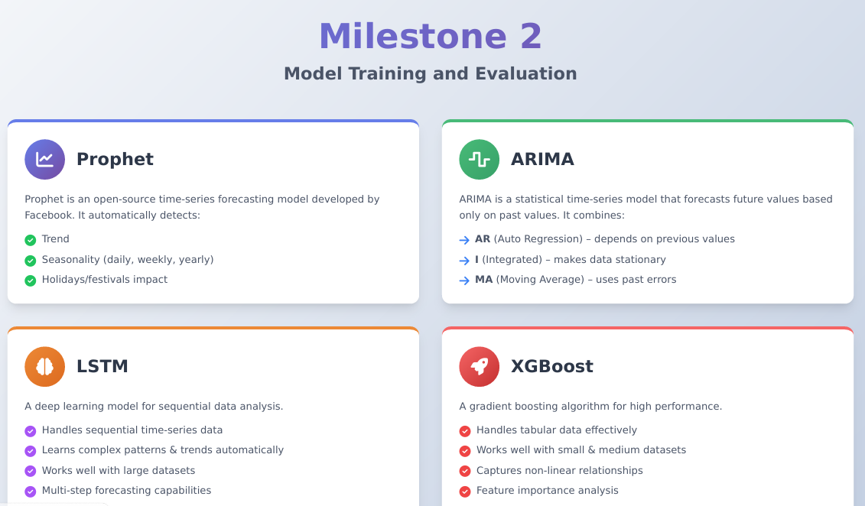

Slide 12
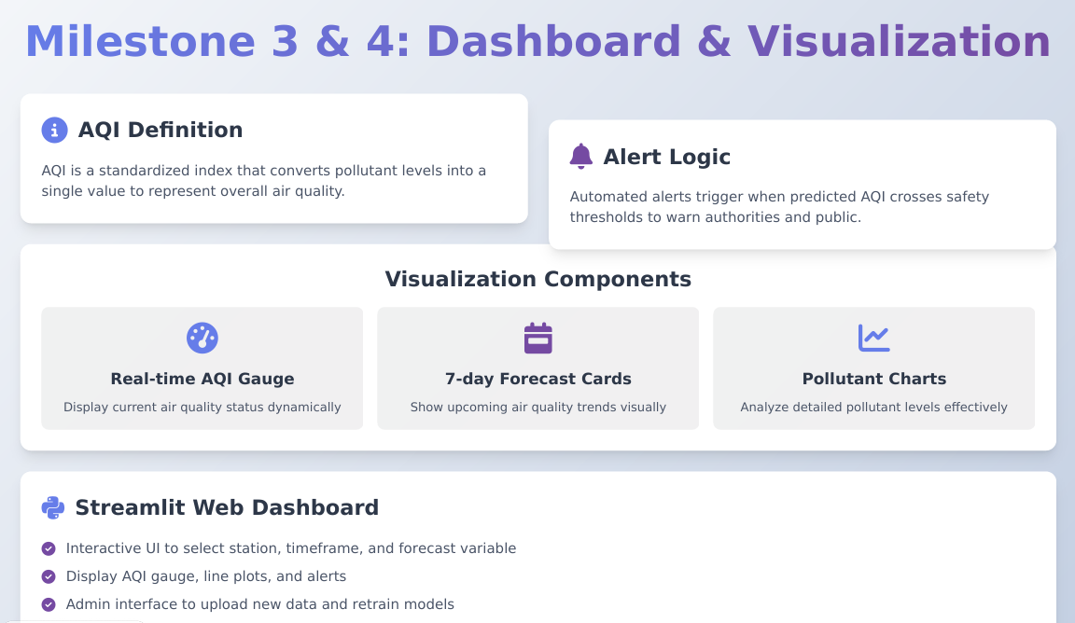

Slide 13








THANK YOU

